Slide 1
Verilog & Vivado quickstart
Stewart dulaney

Slide 2
objective
Get familiar with Verilog and Xilinx Vivado (IDE) and the typical workflow of using a Computer-Aided Design (CAD) Tool in the design of digital systems by implementing a simple combinational circuit

Slide 3
setup
Xilinx provides a free version of the Vivado software called Webpack for Windows and Linux operating systems: https://www.xilinx.com/support/download.html

Slide 4
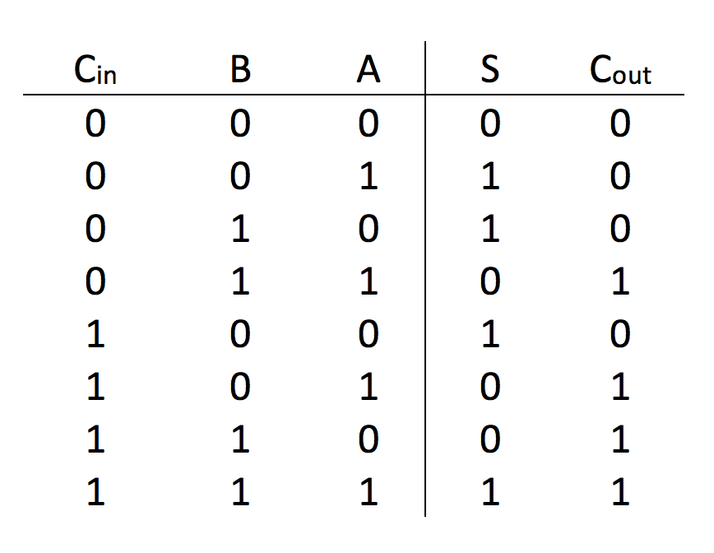
The function of the circuit – full adder
Truth Table

Slide 5
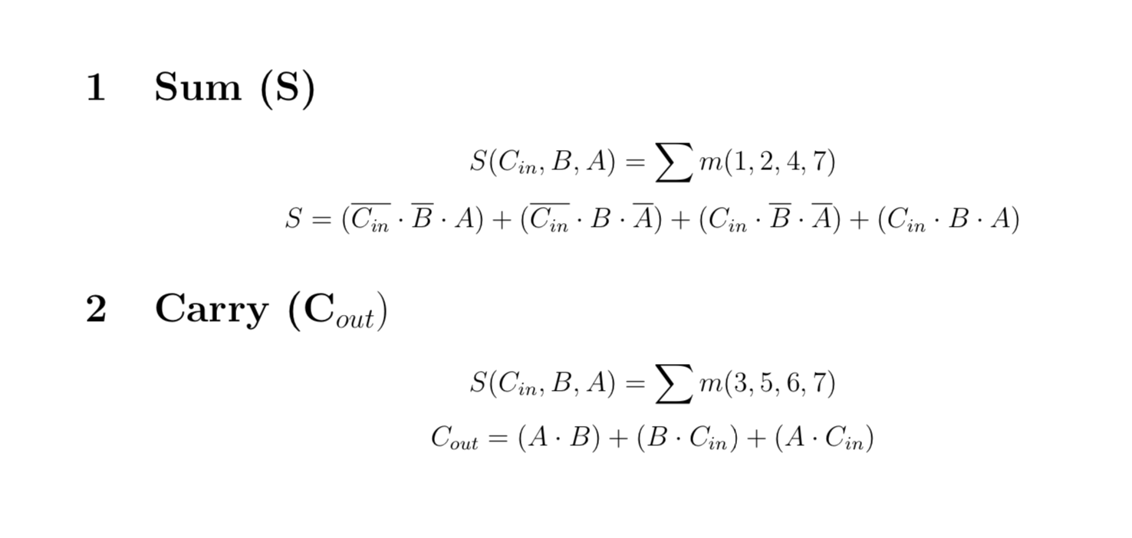
The function of the circuit – full adder
Simplified sum of products expressions

Slide 6
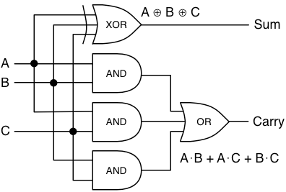
The function of the circuit – full adder
Logic schematic diagram

Slide 7
overview
Create a new project in Vivado
Write Verilog code
Synthesize it
Write testbench file (in Verilog)
Run simulation
Verify the results in the waveform (Timing Diagram)

Slide 8
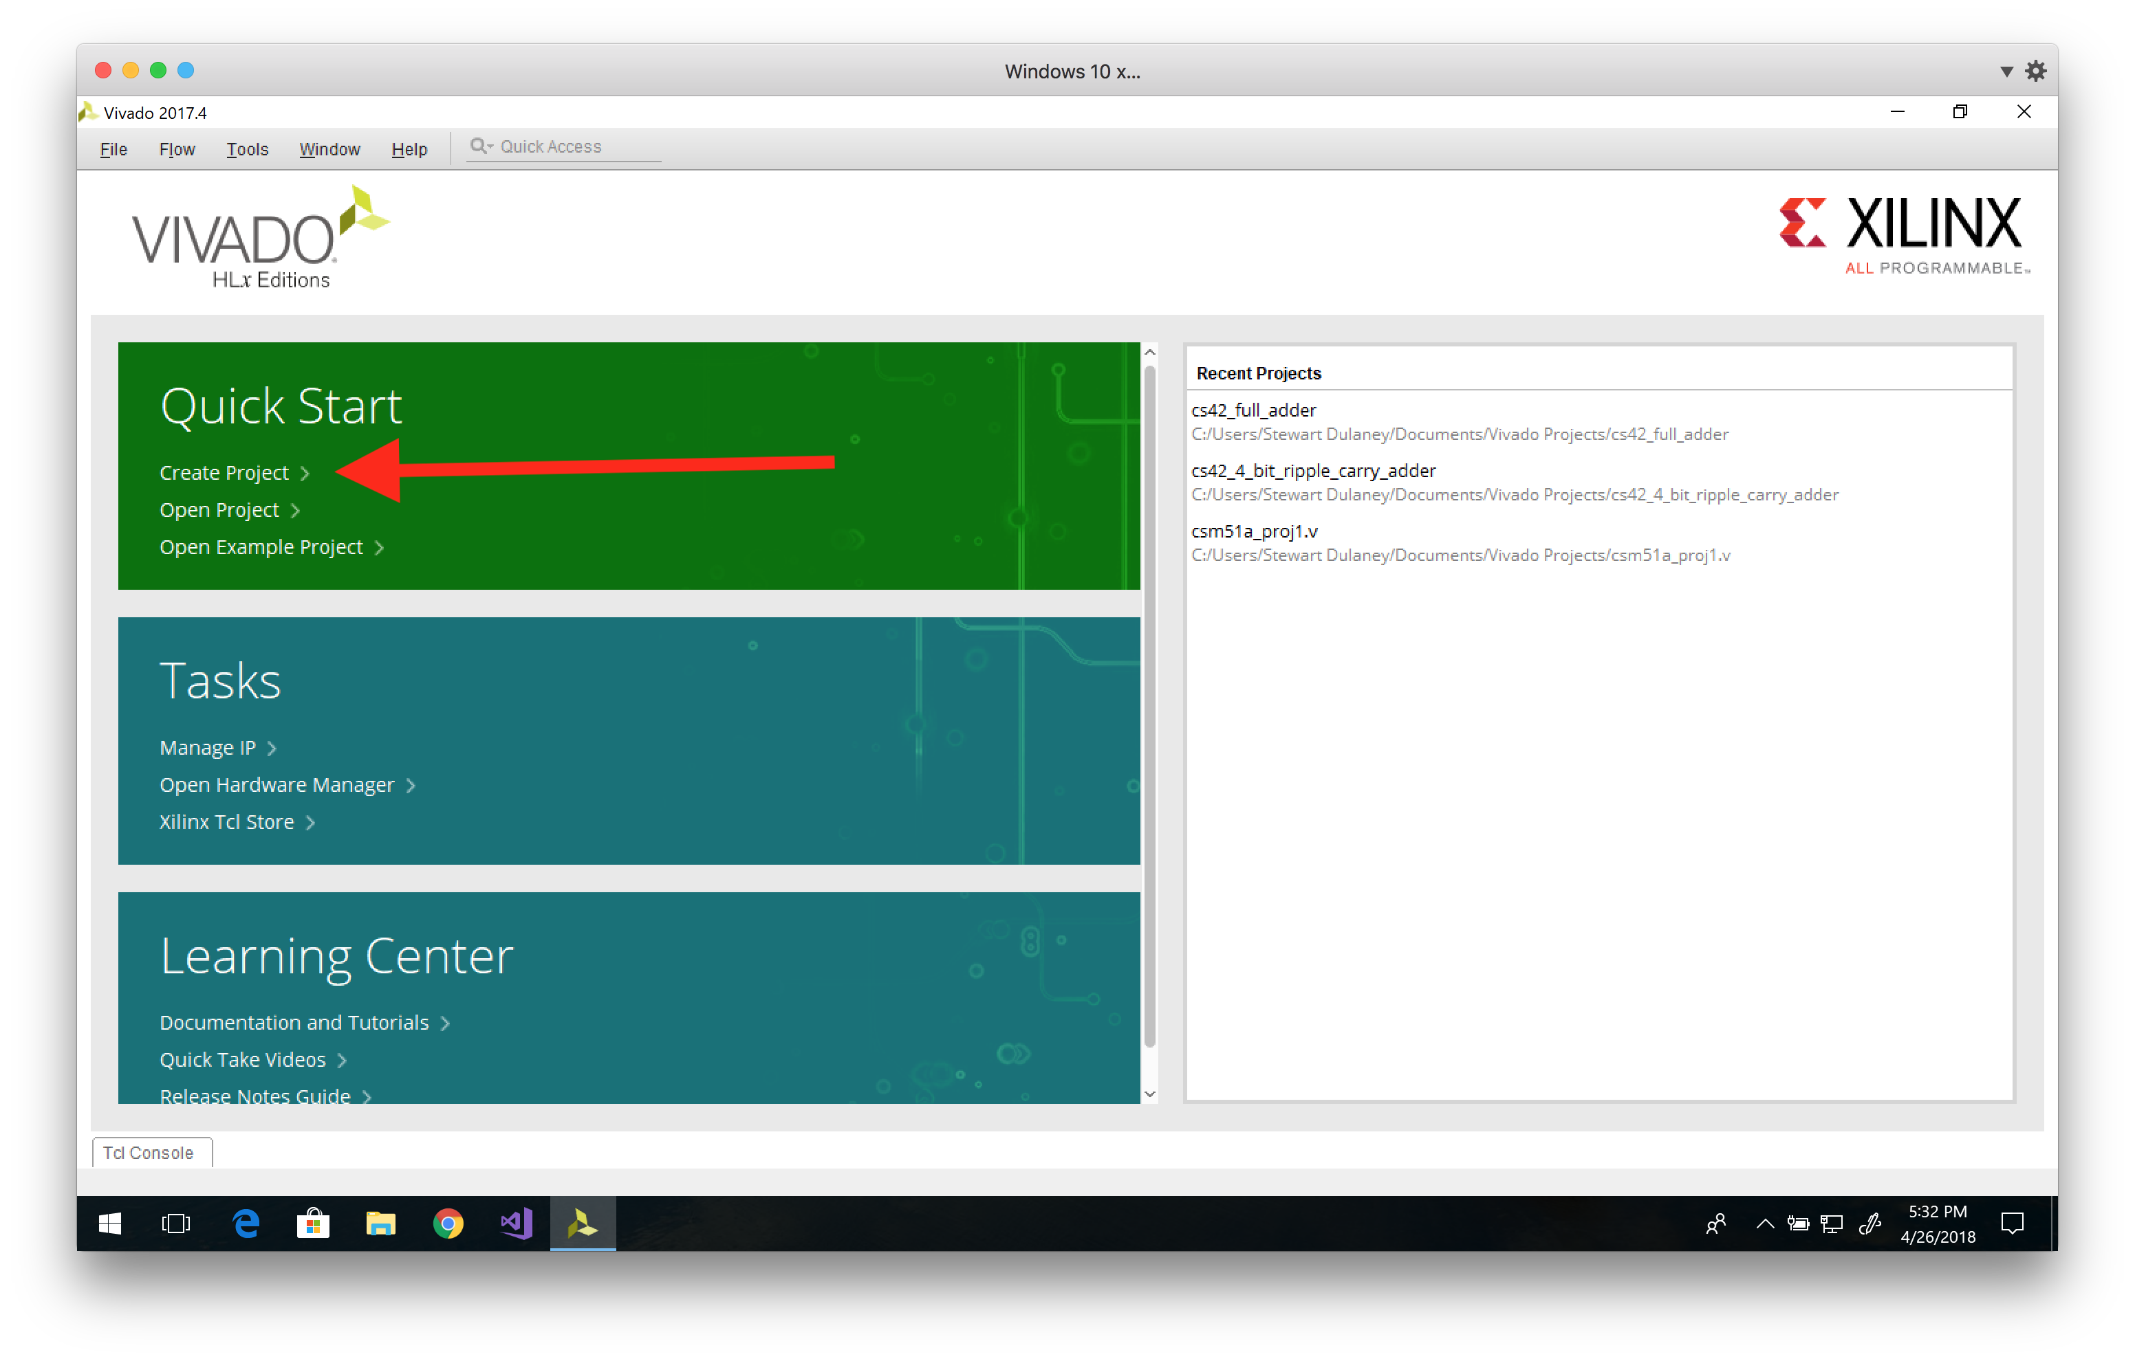
1. Create a new project in Vivado
Splash screen → Create Project → Next → Next → Next → Next → Next → Next → Finish (use default selections)

Slide 9
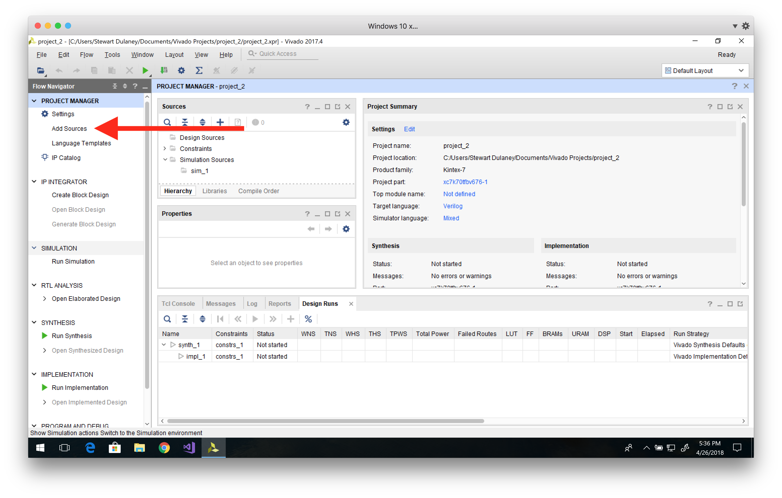
2. Write Verilog code
Add Sources → Add or create design sources → Create File → “full_adder_v” → OK → Finish

Slide 10
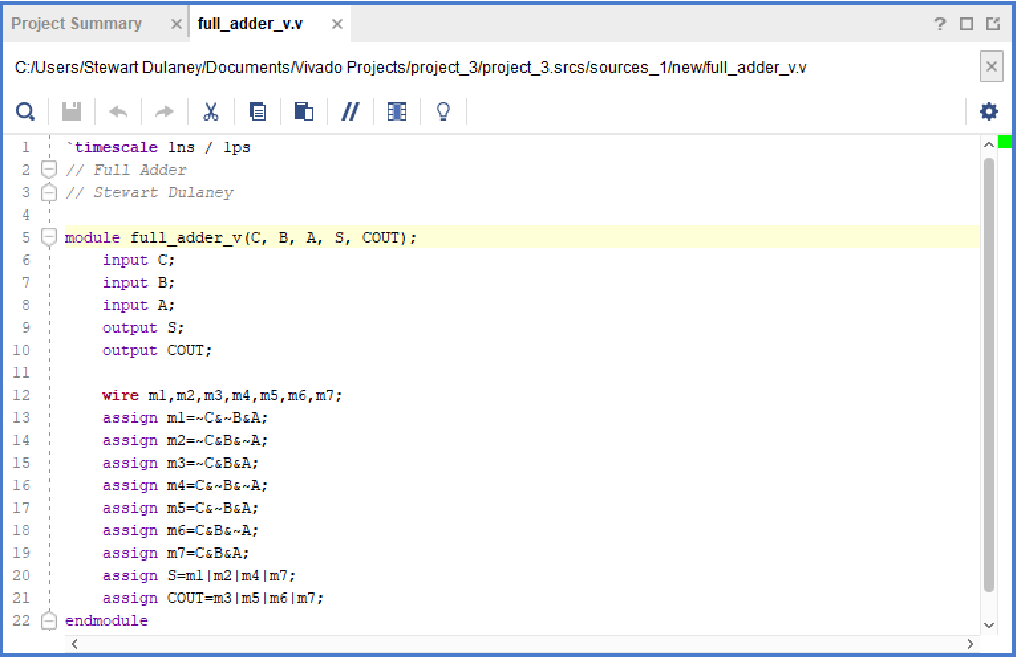
2. Write Verilog code
Notes:
Line 5 – module declaration, fundamental building block of a Verilog design
Lines 6-8 – input declaration
Lines 9-10 – output declaration
Line 12 – declare variables of type wire (the default net type in Verilog) for each minterm needed

Slide 11
2. Write Verilog code
Notes:
Lines 13-19 – assign values to each minterm variable using the Boolean operators “&” and “~”
Lines 20-21 – assign values to each output using the Boolean operator “|”

Slide 12
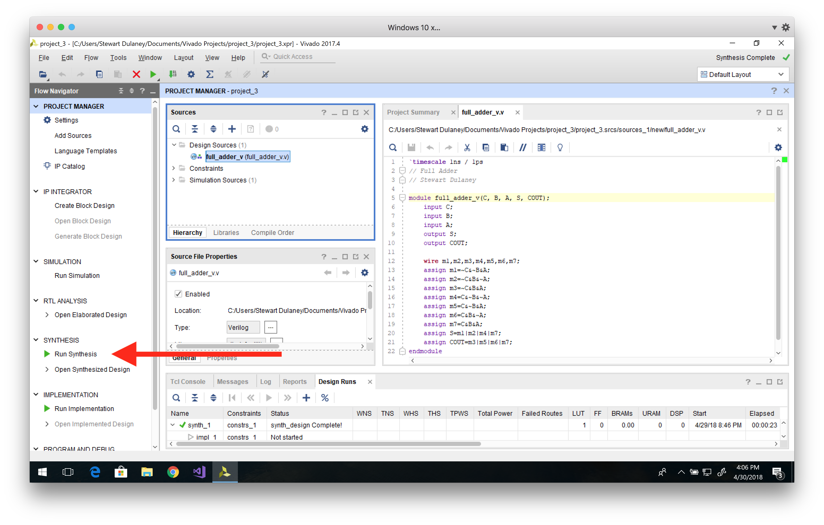
3. Synthesize it

Slide 13
4. Write testbench file (in Verilog)
Add Sources → Add or create simulation sources → Create File → “sim” → OK → Finish

Slide 14
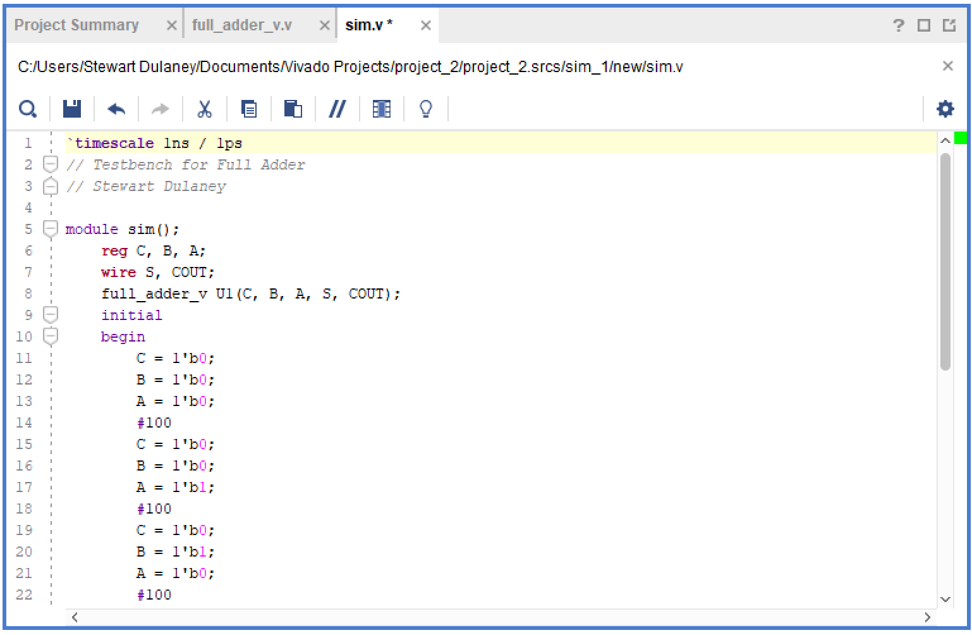
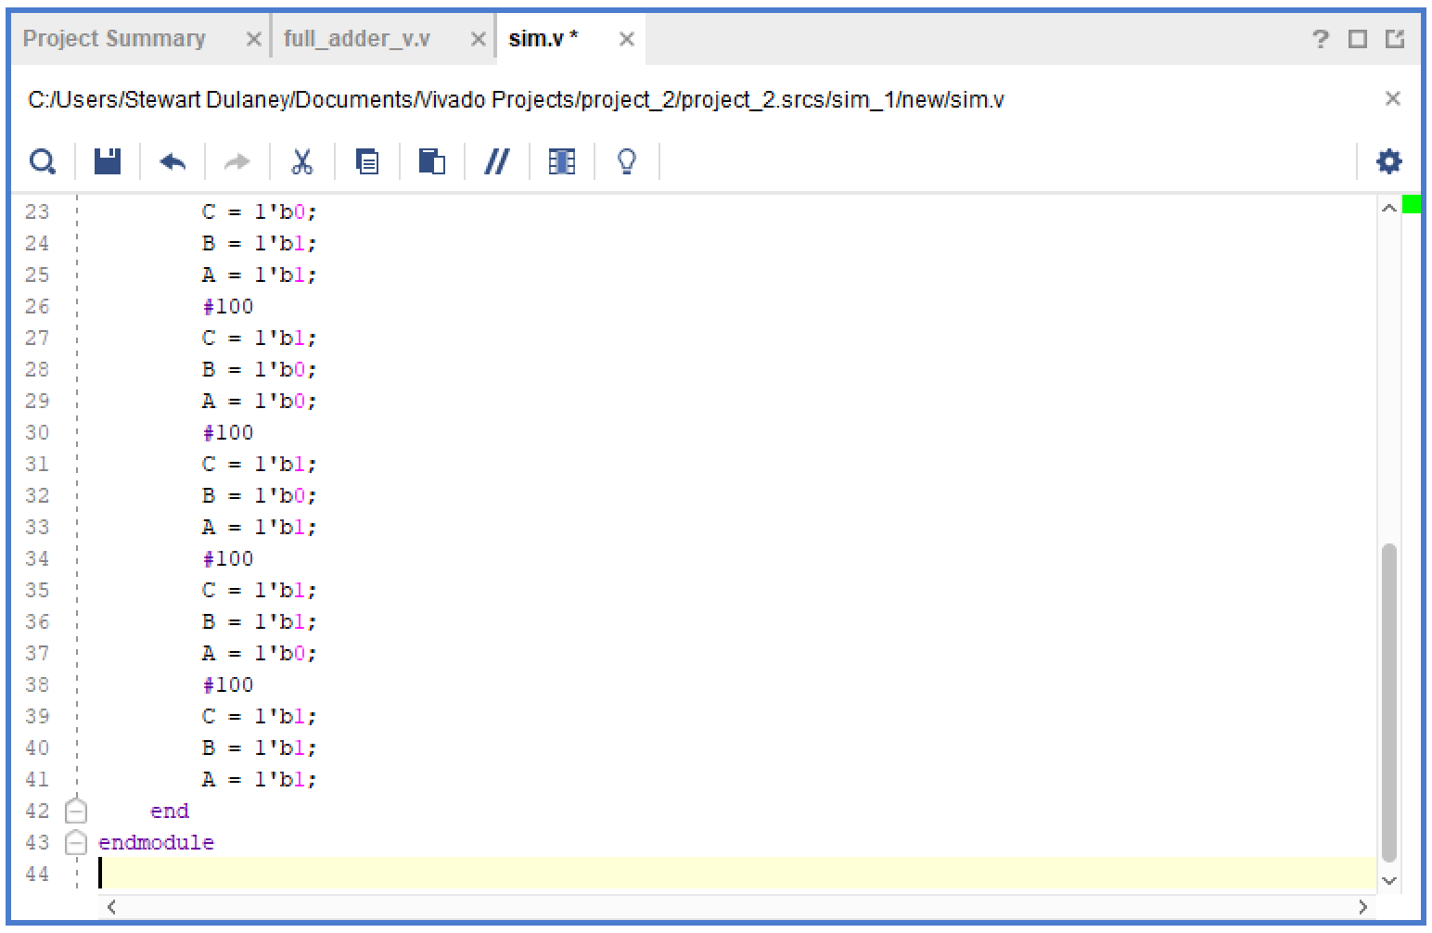
4. Write testbench file (in Verilog)
Notes:
Line 5 – declare a module with no input or output ports
Line 6 – declare the registers (variables) that will be connected to the inputs of the DUT
Line 7 – declare the wires that will be connected to the outputs of the DUT
Line 8 – declare an instance of full_adder_v with name U1 (arbitrary) and specified inputs/outputs
Lines 9-42 – the testbench applies combinations of inputs to the DUT using a process, which is a block of statements that are executed sequentially
Line 9 – the process runs once at the beginning of the simulation because of the keyword initial
Lines 11-13 – each variable is assigned a 1 bit binary value
Line 14 – wait 100 units of simulation time between assignments (delays specified with the “#” operator)

Slide 15
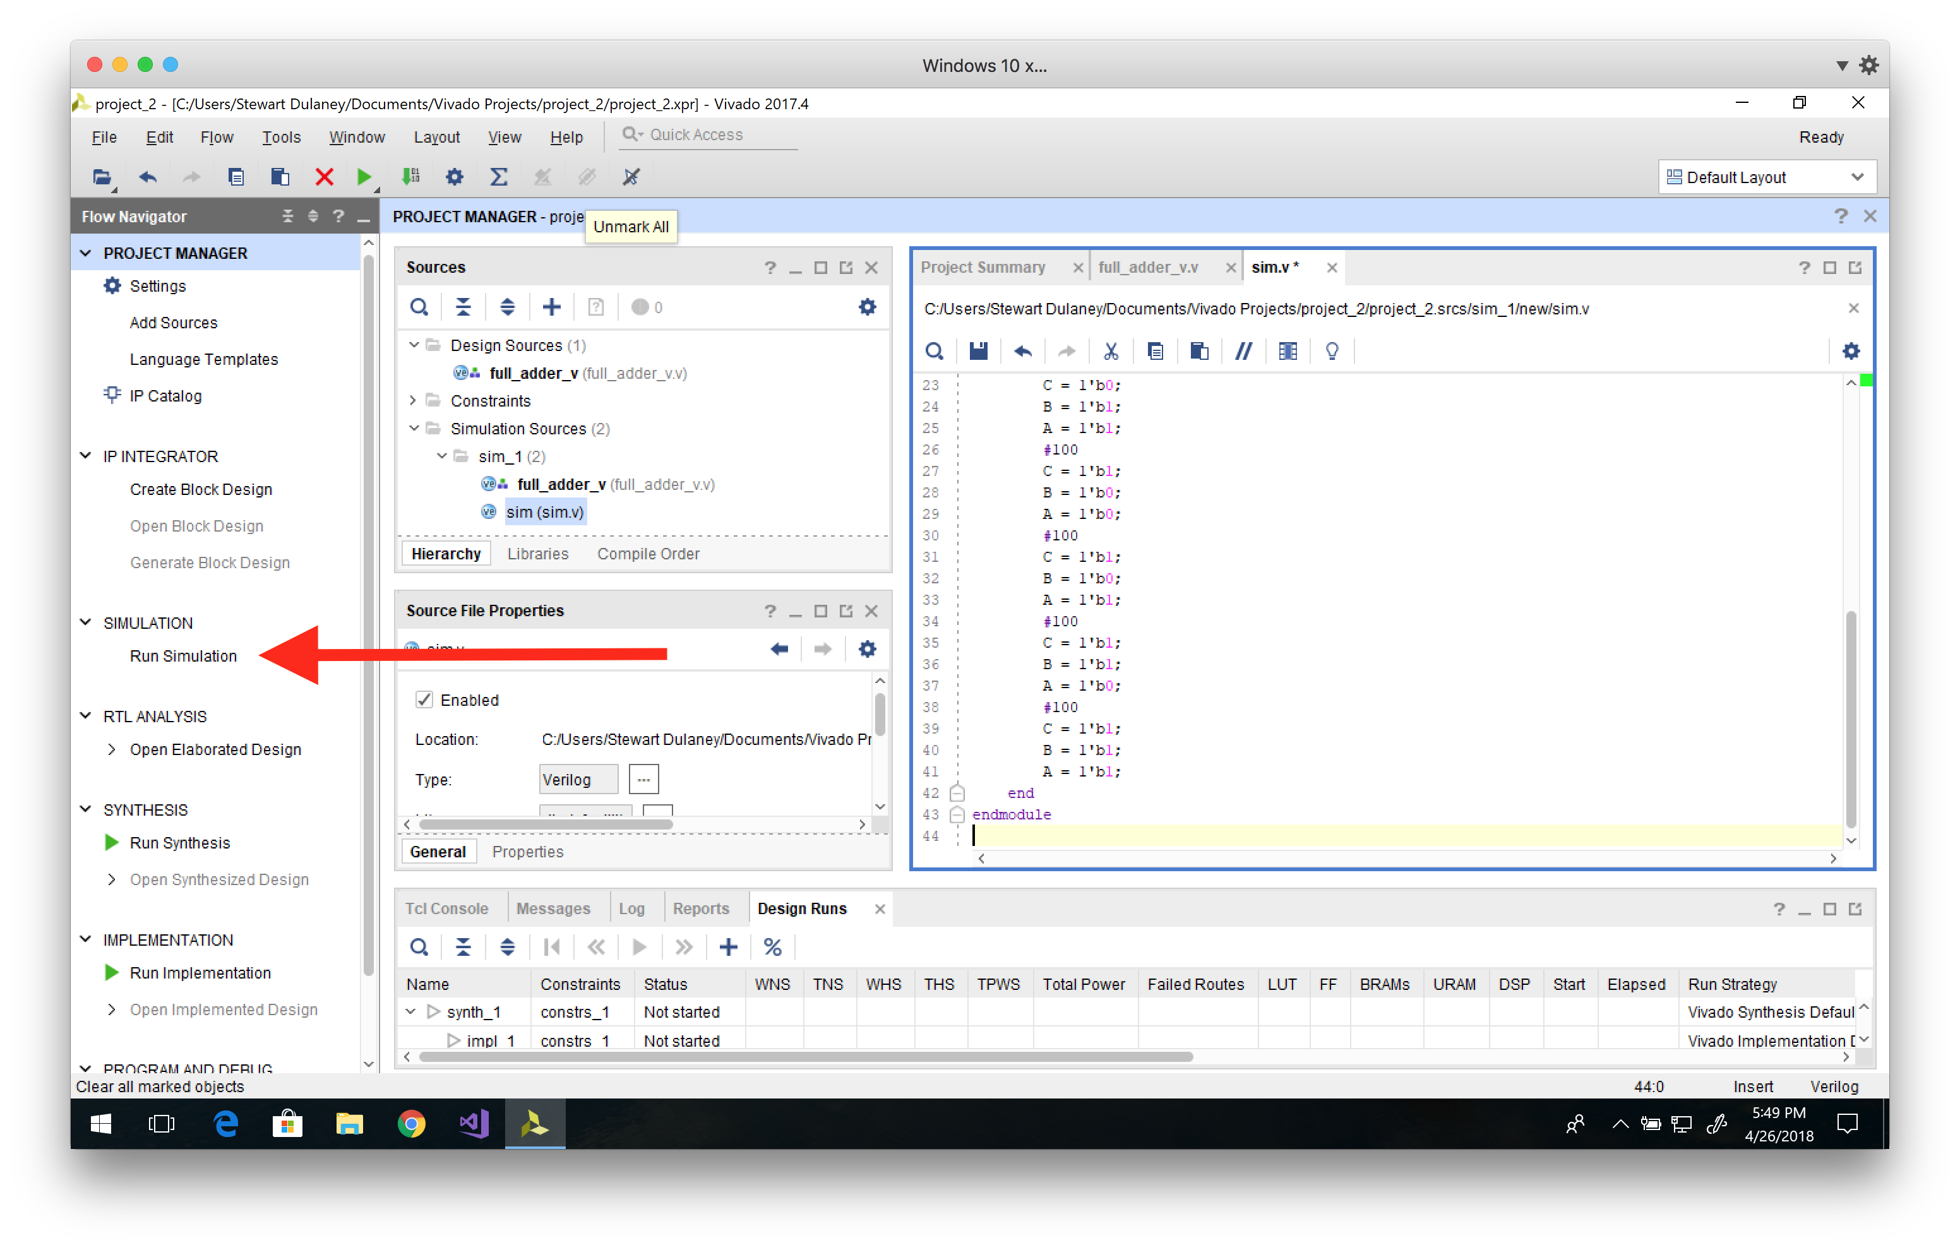
5. Run simulation

Slide 16
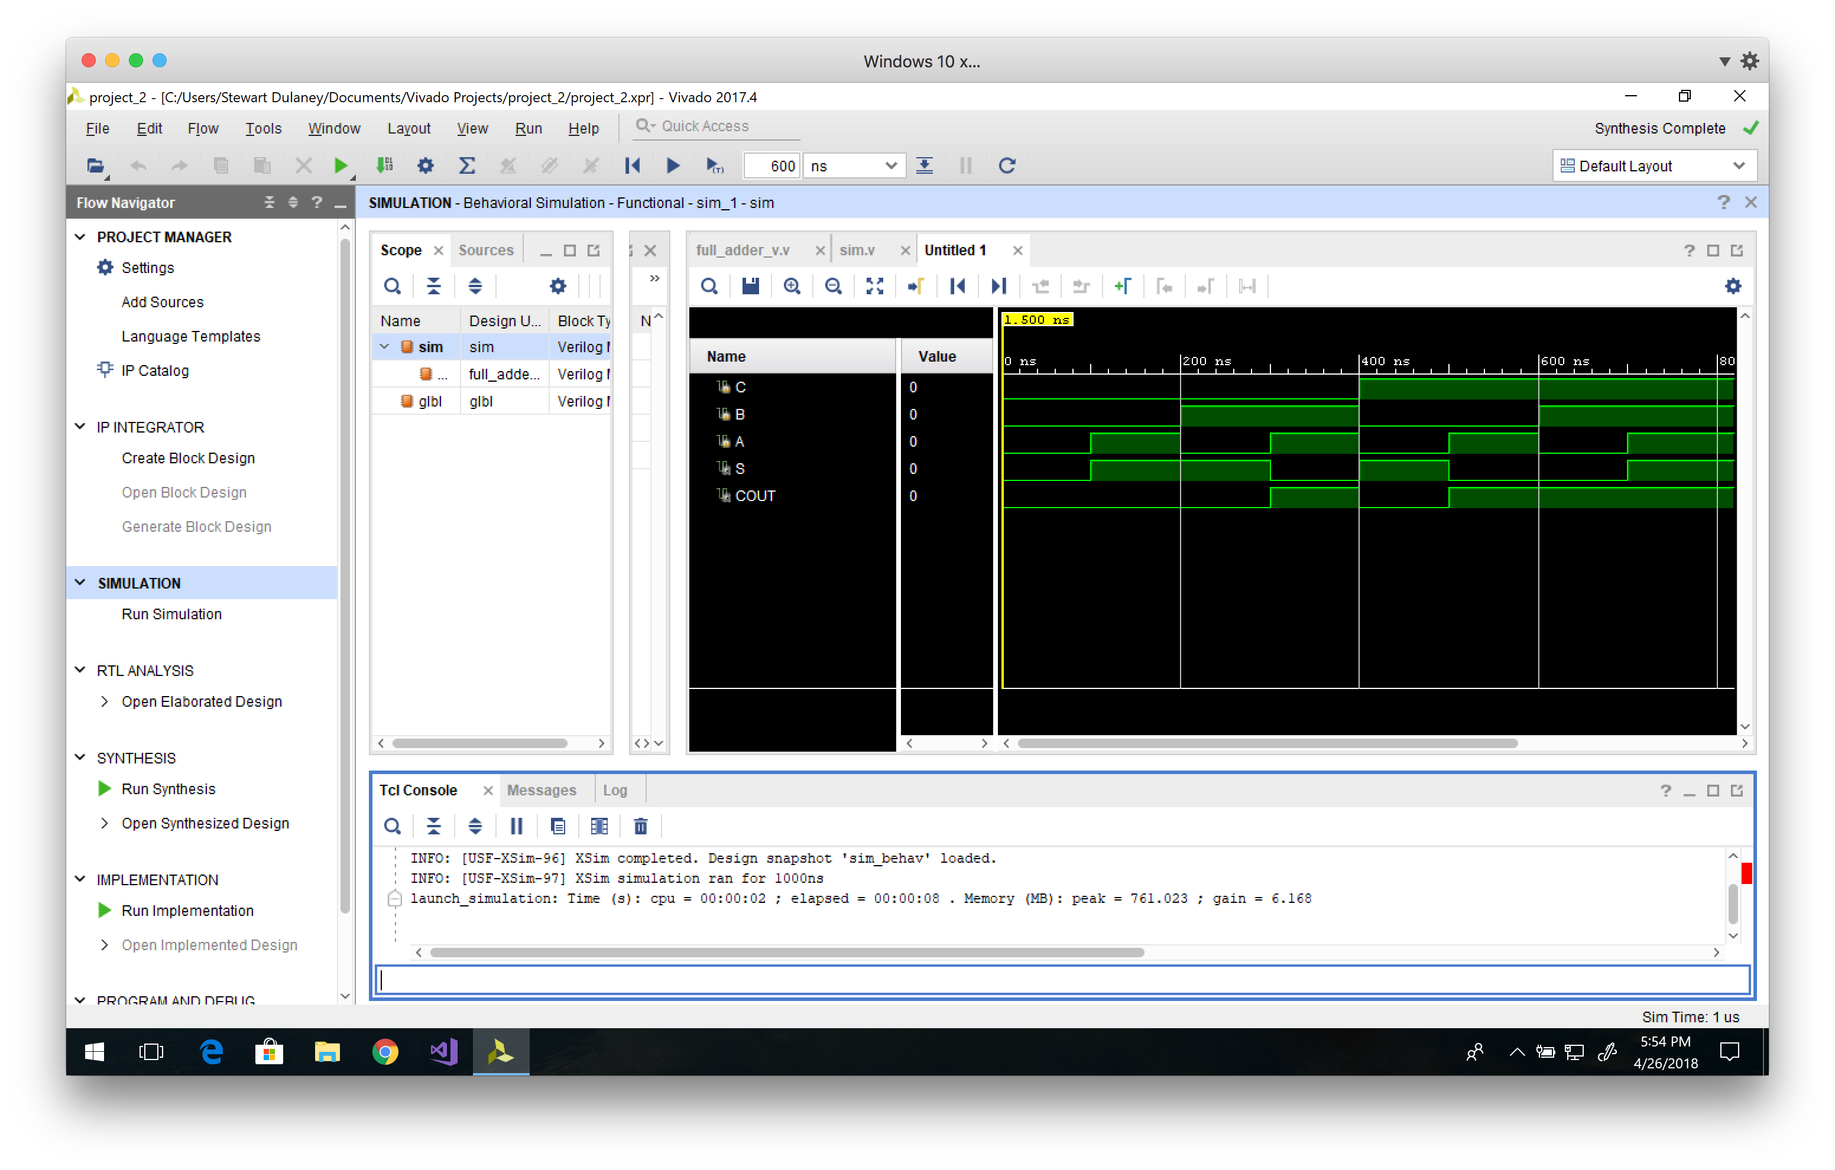
6. Verify the results in the waveform (Timing Diagram)

Slide 17
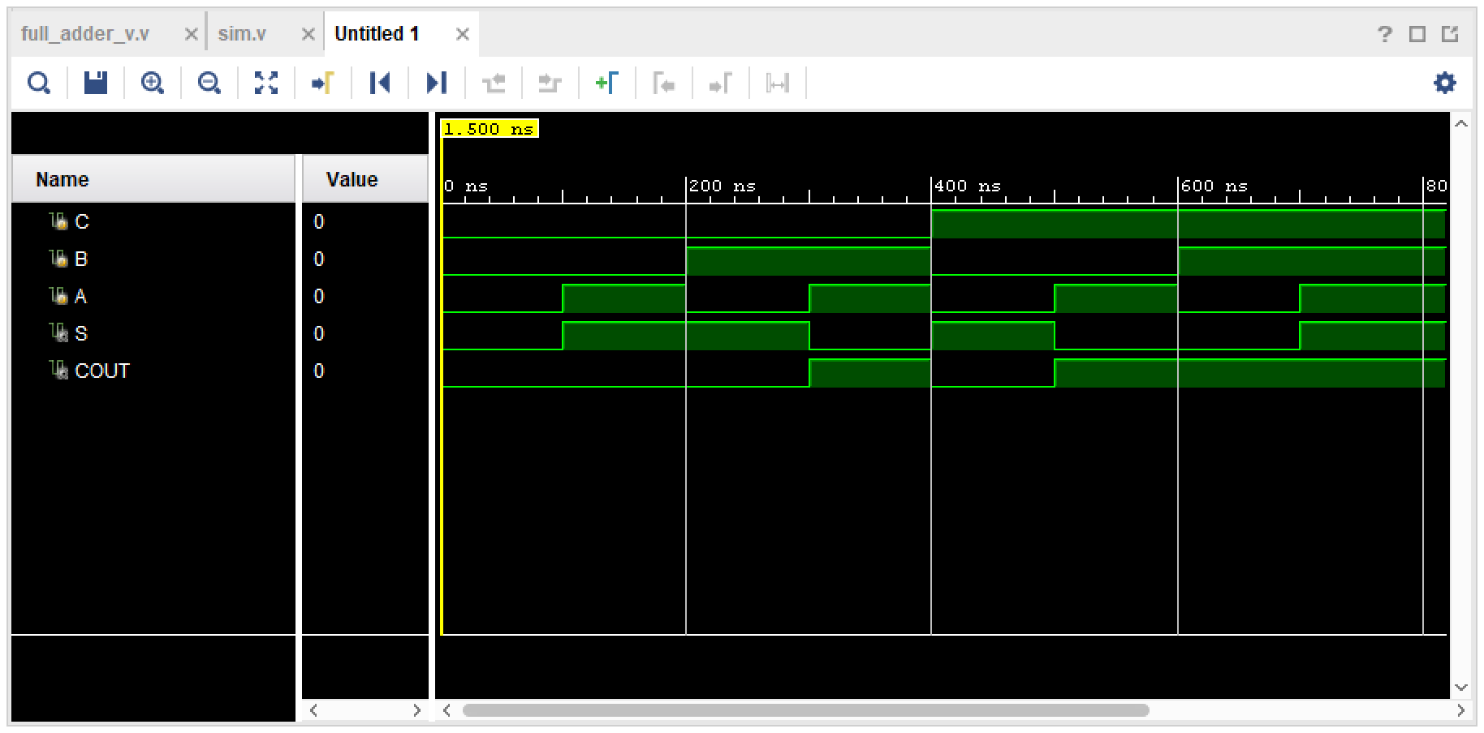
6. Verify the results in the waveform (Timing Diagram)

Slide 18
The end
Download slides and code: http://bit.ly/verilogquickstart

